Slide 1
Sample tilt and how to compensate

Slide 2
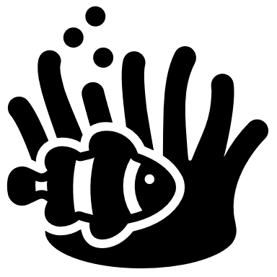
Tilt Experiments
FOV
1. Move same object around to all 4 corners of FOV and record focus z pos in each corner
2. Determine error via focusing on same object in same spot 5 times and recording z pos.
3. Approximate Depth of Field (DOF) by observing range of z pos where same object still looks pretty in focus
4. Go to 5 different random XY cords and record z focus. Extrapolate out tilt and find difference to quantify how tissue deviates from glass tilt
4744.5um
4750.9um
4747.6um
4754.2um

Slide 3
Data
Tilted corner data
Corner 0 | Corner 1 | Corner 2 | Corner 3
4750.9 | 4754.2 | 4744.5 | 4747.6
4743.0 | 4744.5 | 4737.0 | 4739.0
4736.0 | 4739.0 | 4731.0 | 4733.5
4749.6 | 4753.2 | 4745.4 | 4746.3
2
0
3
1
Repeated focusing of same spot and object data (determining error)
Repeat Count | Z pos of focus
1 | 4748.9
2 | 4748.0
3 | 4747.5
4 | 4748.0
5 | 4748.3
Depth of Focus (DOF)
+-2-3um (5-6um range)
Image y pixel count | Image x pixel count
560 | 956

Slide 4
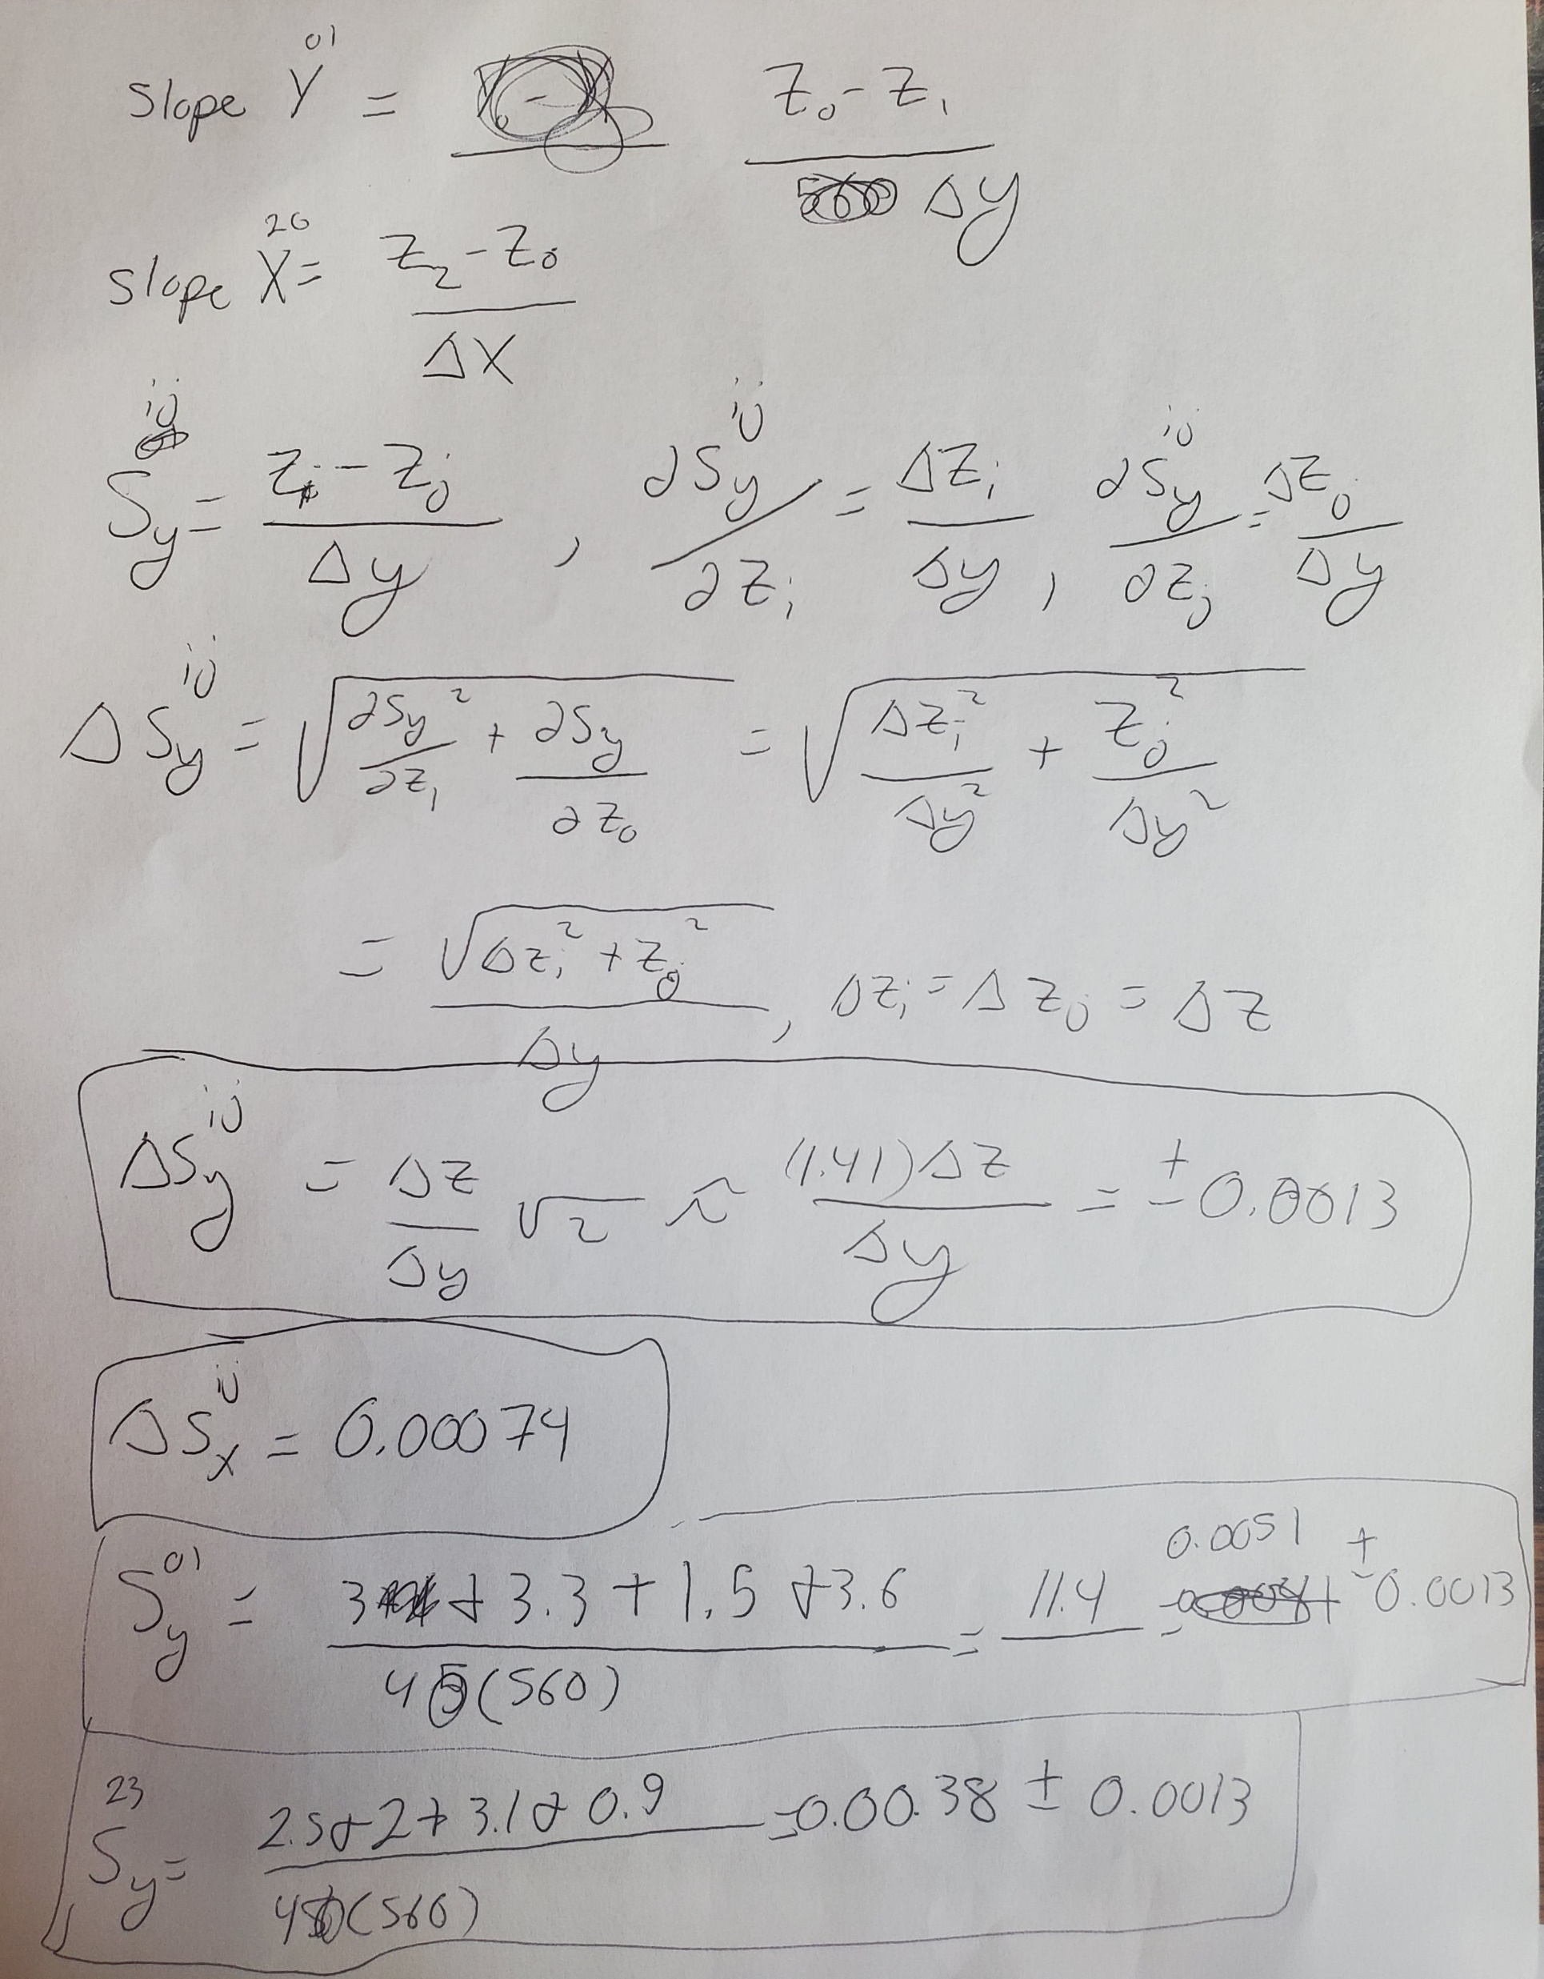
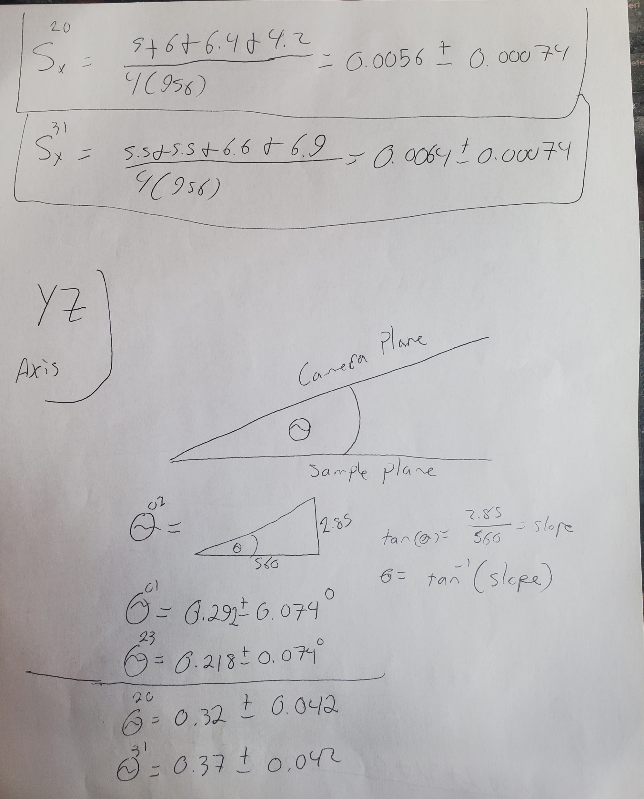
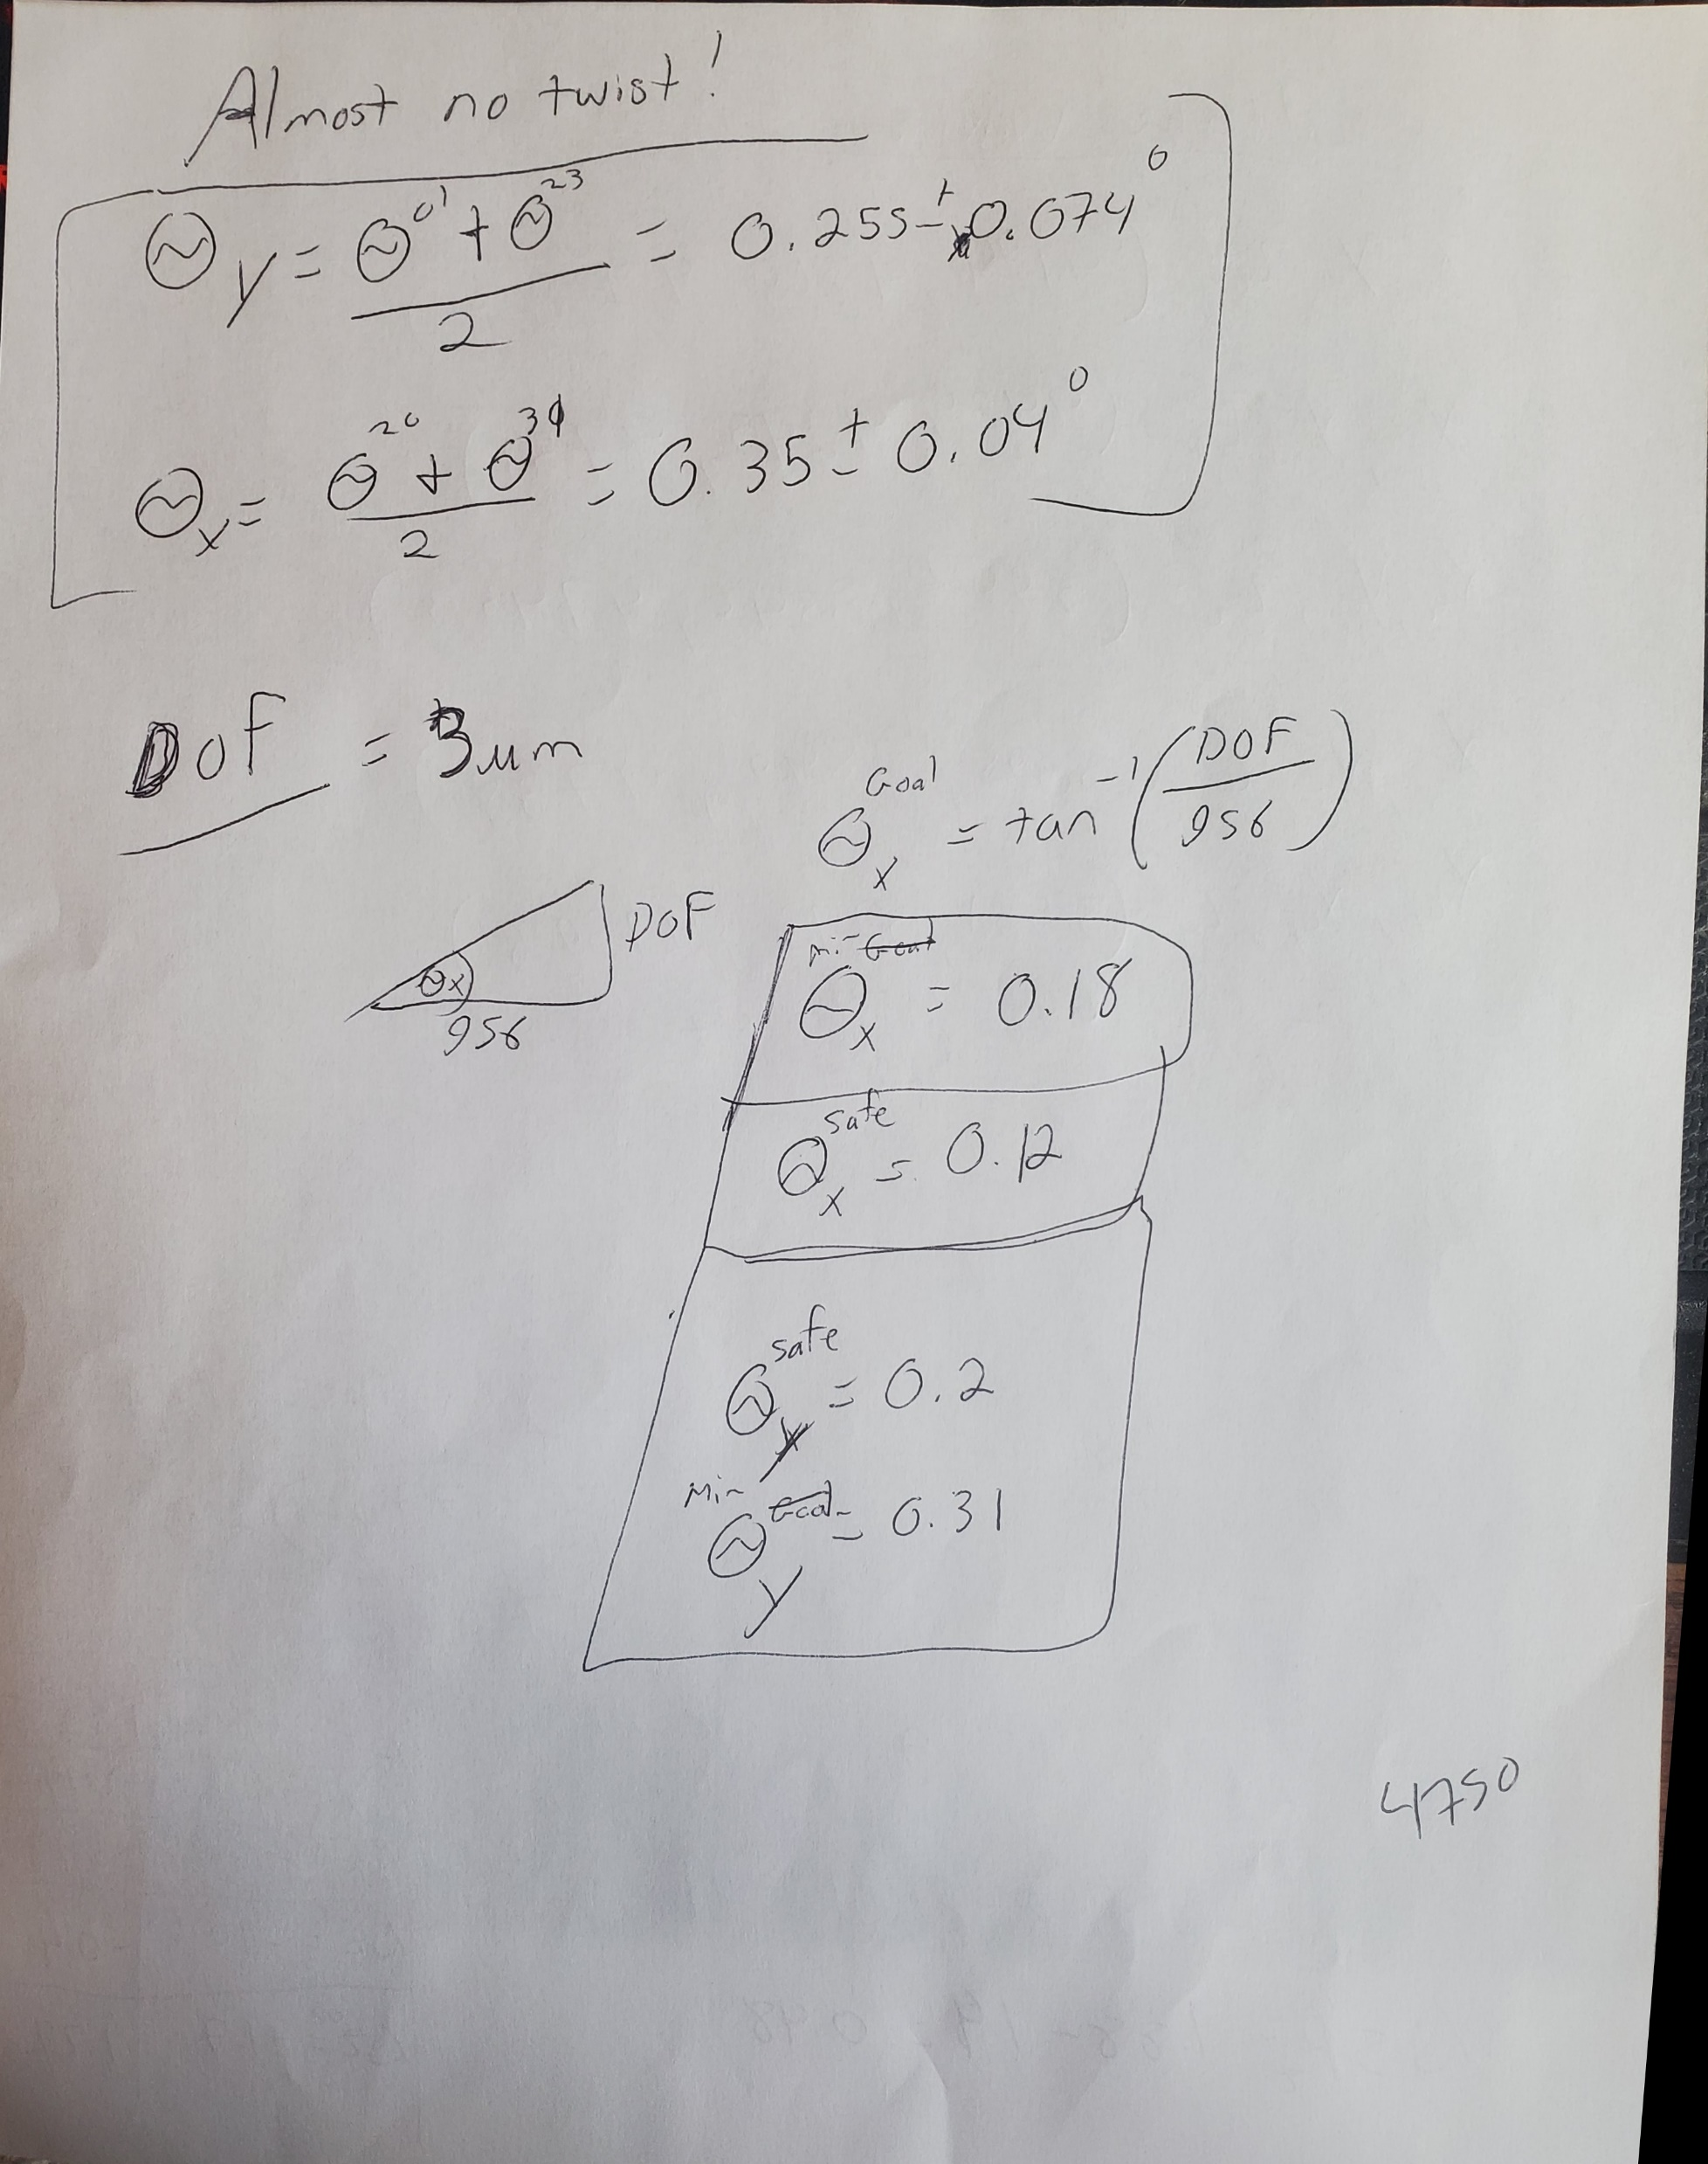
Pictures of notes

Slide 5
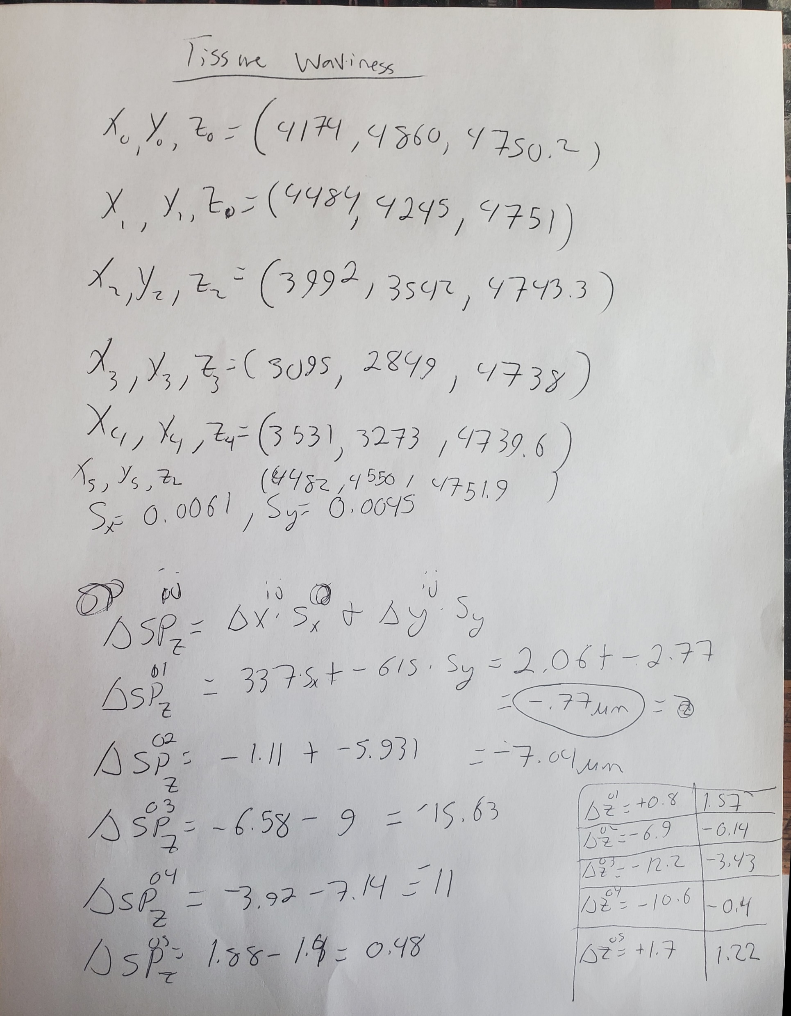
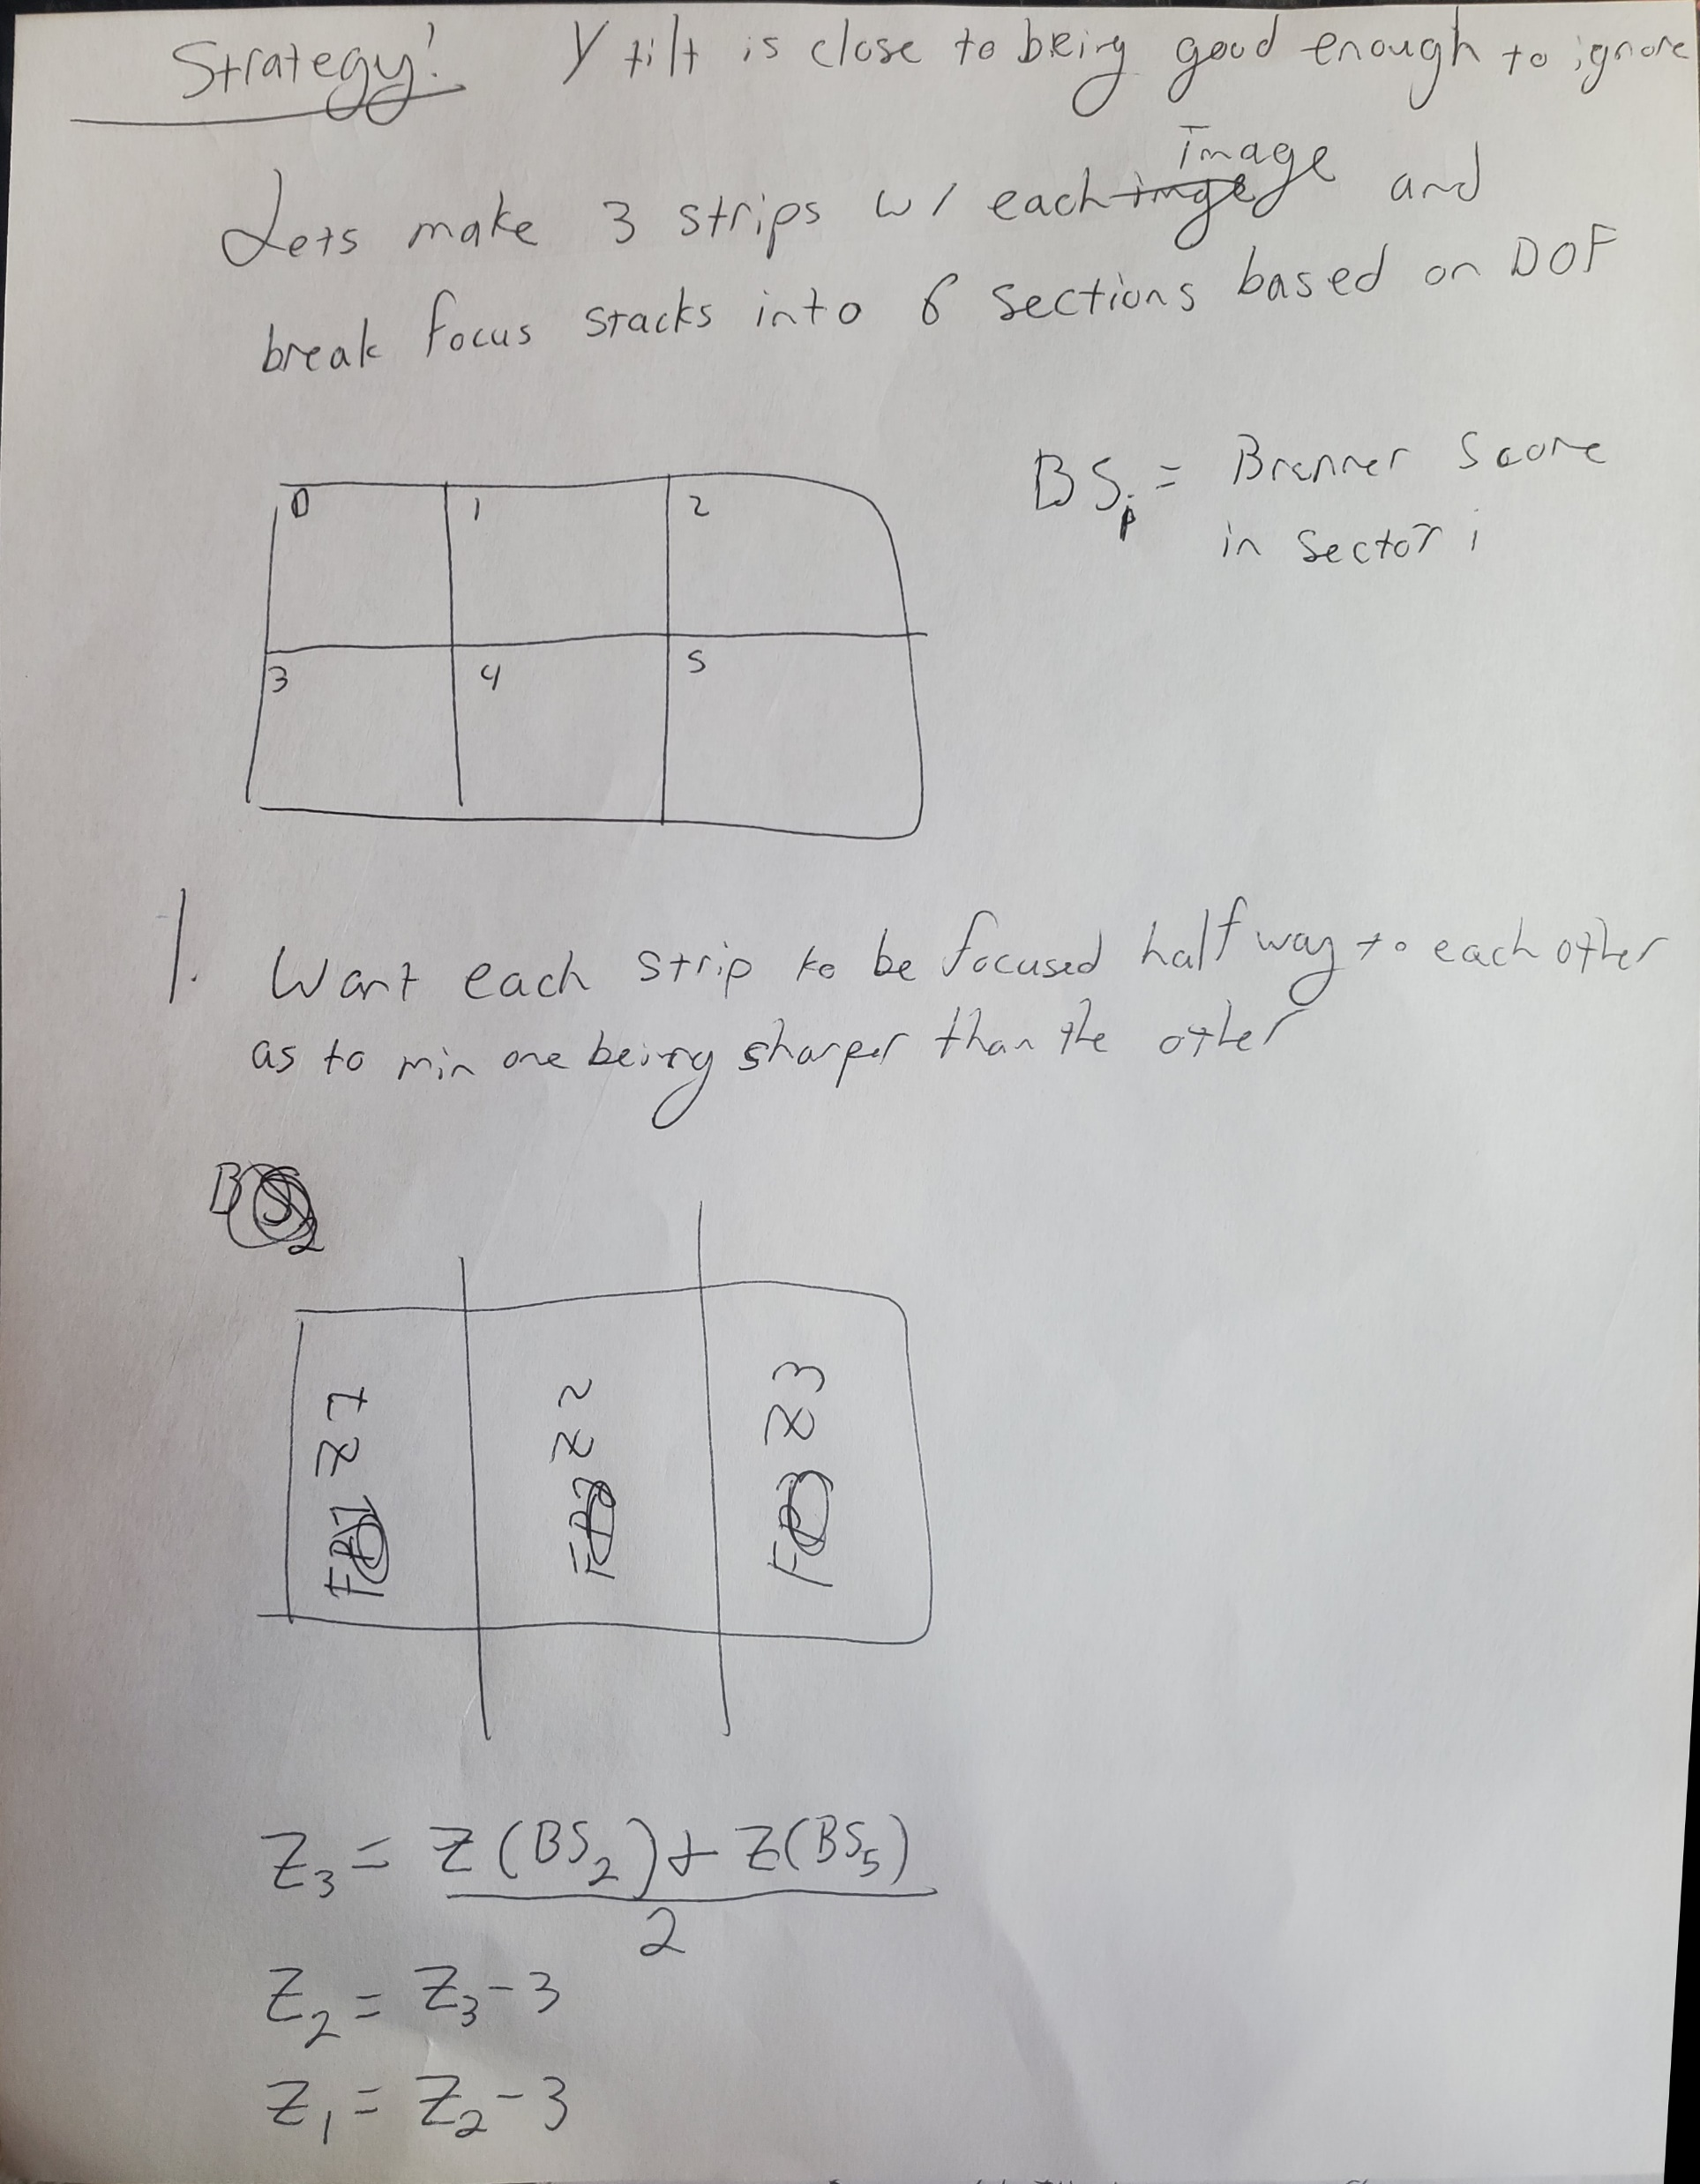
Cont

Slide 6
Findings
Angle of X_tilt = 0.35 +- 0.04 degrees and Y_tilt = 0.26 +- 0.08 degrees
With a DOF of focus +- 2um, X_tilt needs to be < 0.12 degrees and Y_tilt < 0.2 degrees.
Extrapolation of FOV tilt to large distance (single digit mm scale) seems like viable strategy
Tissue appears to have waviness on orders of DOF that are on length scales larger than the FOV which means that a super flat slide should work well with no additional strategies.
2 angles (YZ angle, XZ angle) are sufficient to describe slide tilt (which is expected given it’s a rigid object)

Slide 7
Going Foward
I see 2 main ways forward. One is to compensate; the other is to level better.

Slide 8
Level Strats
Style #1
I cannot level by eye well enough. Need way to automatically quantify info.
Manually change levelling screws
Pycromanager takes 4 stacked images (places same object in each corner with known displacement).
Use brenner score in only a box near the designated corner for each stack
Calc and read back angles.
Style #2
Implement a thor labs leveling mech on top of auto quantify program

Slide 9
Compensation example algorithm
Find spot with tissue covering vast majority of FOV
Break into 2 rows and 3 columns
Use brenner score in 4 corners to determine tilt
Extrapolate tilt to act as seed value to any other point (thus tissue focus is seed +- an input range like 5um).
When imaging, take 3 images, 3um in z apart from each other and assemble new image that is formed from vertical strips from the 3 images.

Slide 10
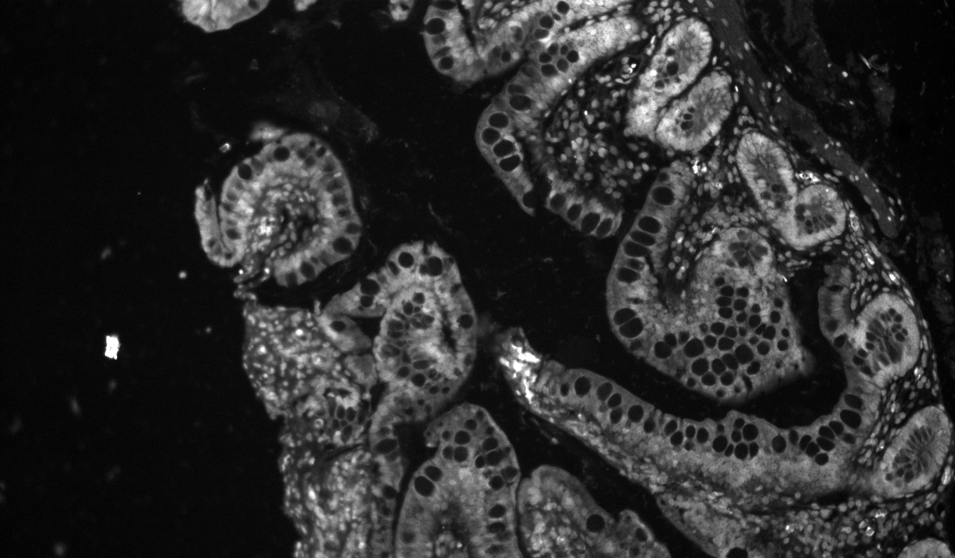
Example 3 strip image
Following image was assembled via taking 3 strip columns from 3 images that differed by 3um z between each one
Right

Slide 11
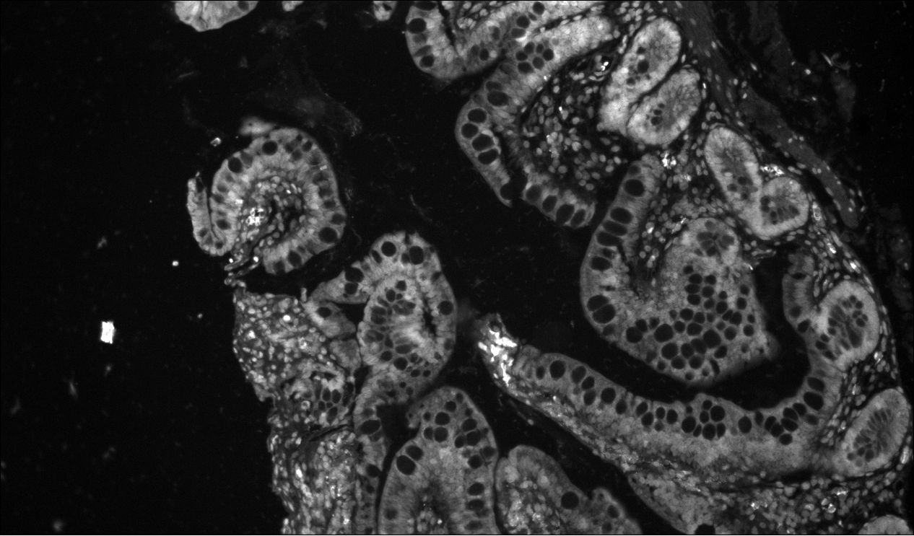
Example 3 strip image
Following image was assembled via taking 3 strip columns from 3 images that differed by 3um z between each one
Middle

Slide 12

Example 3 strip image
Following image was assembled via taking 3 strip columns from 3 images that differed by 3um z between each one
Left

Slide 13

Example 3 strip image
Following image was assembled via taking 3 strip columns from 3 images that differed by 3um z between each one
3 strip

Slide 14
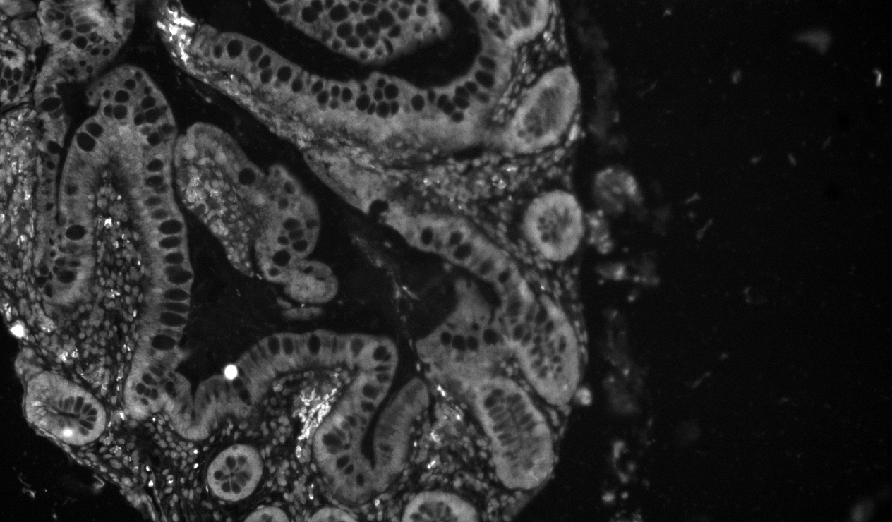
Example 3 strip image
Following image was assembled via taking 3 strip columns from 3 images that differed by 3um z between each one
Left

Slide 15
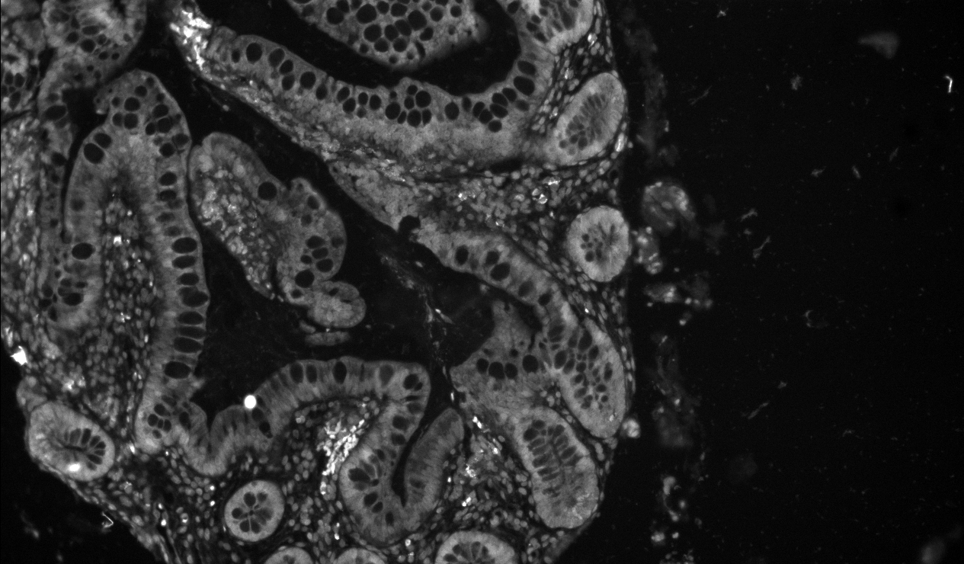
Example 3 strip image
Following image was assembled via taking 3 strip columns from 3 images that differed by 3um z between each one
Middle

Slide 16

Example 3 strip image
Following image was assembled via taking 3 strip columns from 3 images that differed by 3um z between each one
Right

Slide 17

Example 3 strip image
Following image was assembled via taking 3 strip columns from 3 images that differed by 3um z between each one
Three Strip

Slide 18
Simplest Solutions
Only focus middle 9th of image. Up and down will be fine, but sides will be ever so blurred.
Reduce FOV to a ¼ chip. Maybe this in combo with a middle focus would make everything very good with the current levelness of the slide.

Slide 19
Suggested Route Forward
Auto focus middle 9th of image. This might be good enough to get something right now.
Add on feature extraction into autofocus. Its solely to determine where tissue is and only use those pixels towards the brenner score. Example could be to get predicted z from brenner, use that z slice to implement Lorentzian filter to isolate tissue, recalc for entire stack using those bounds ,(maybe bleed out a bit to include blur. If no tissue exists, move around to different section or if no tissue exists in entire image, use adjacent tile’s z.
Develop autofocus method to quantify tilt to aid leveling

